Slide 1
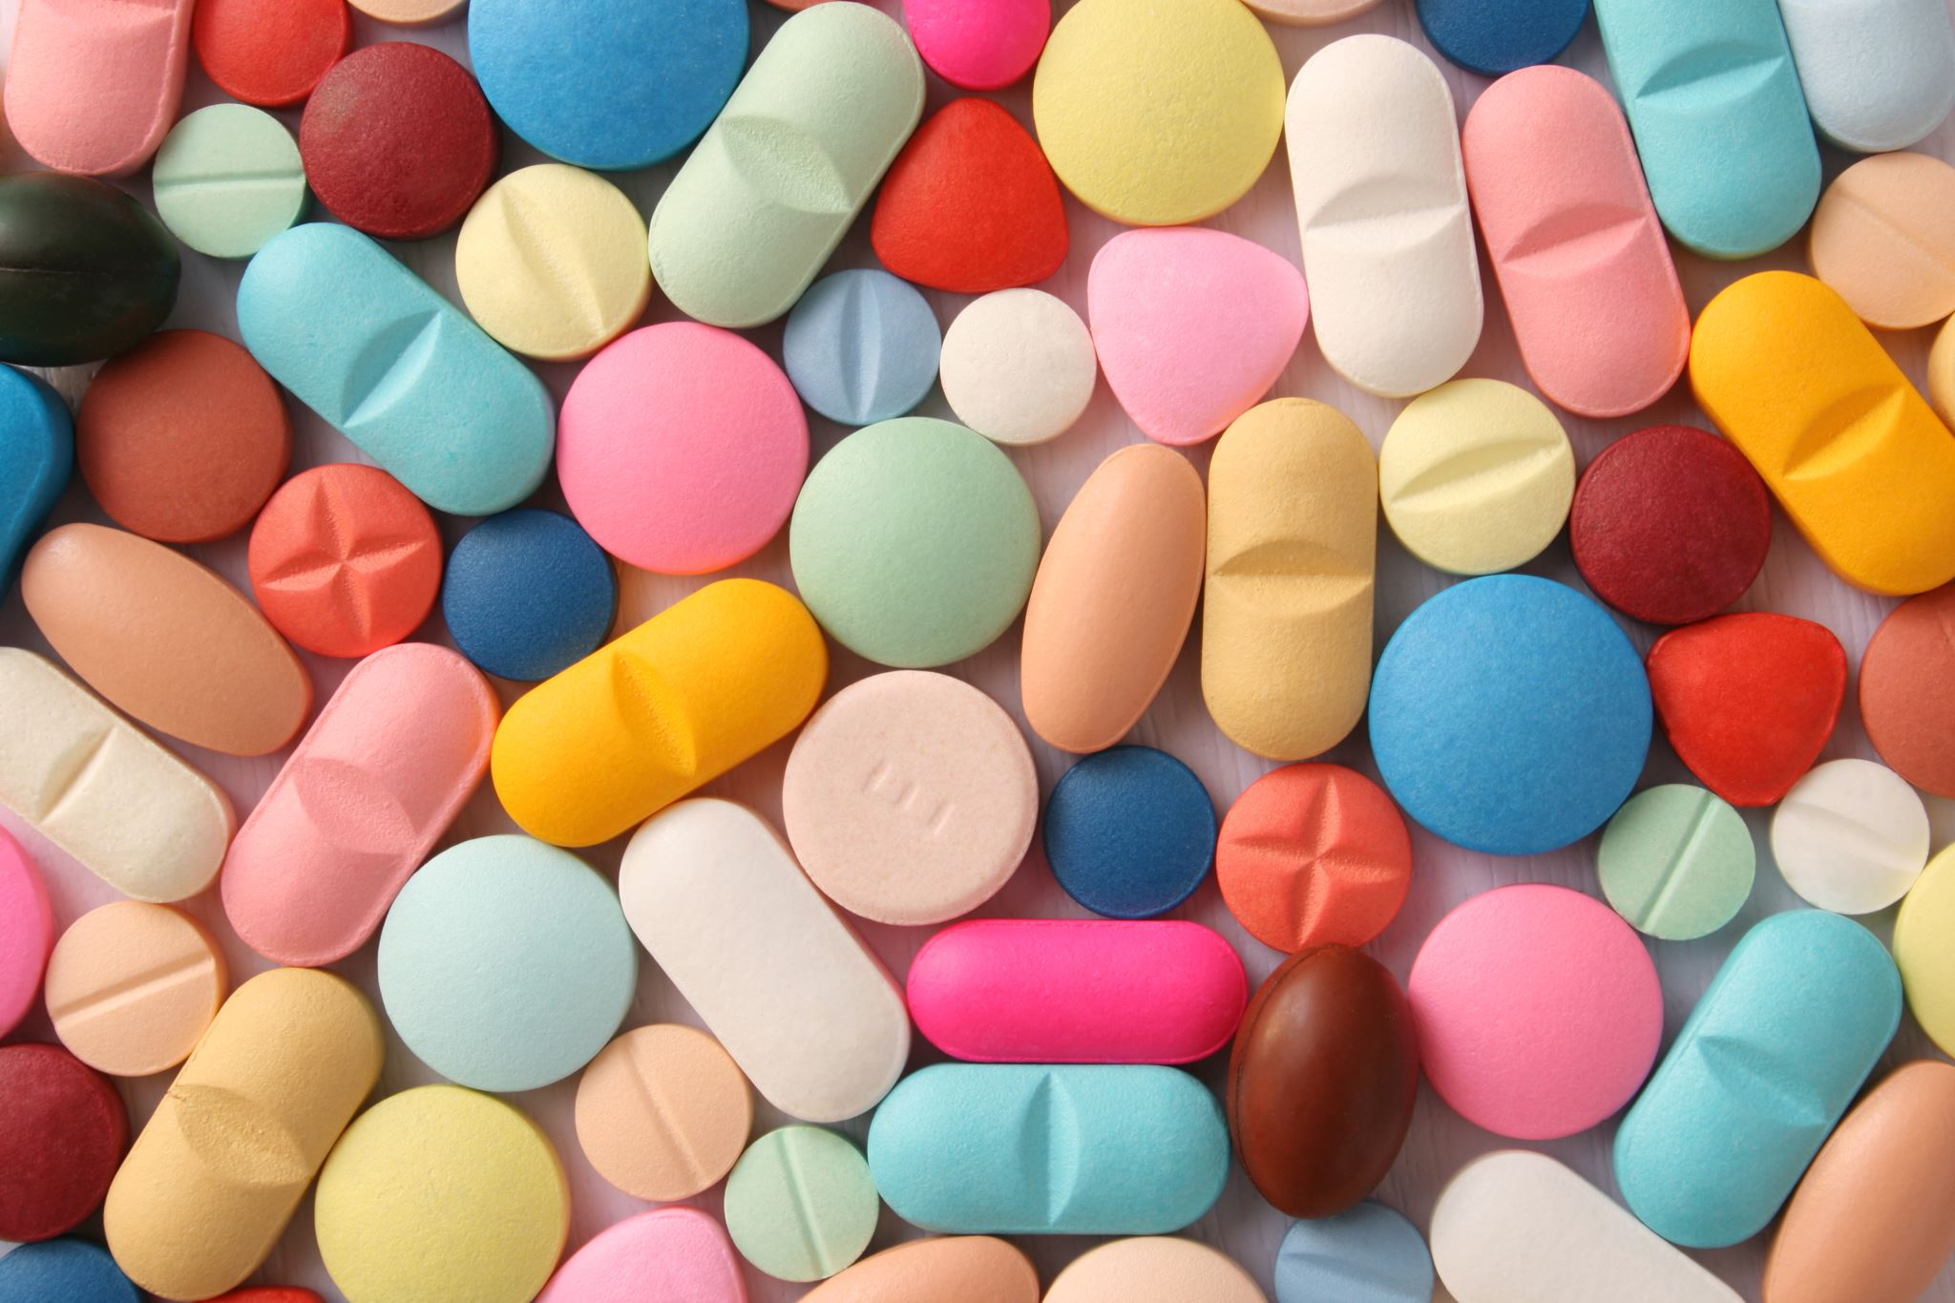
TOXICITY PREDICTION ON DAILY MEDICATION
24AIM112 – Molecular Biology and Basic Cellular Physiology
24AIM115 – Ethics, Innovative research, Businesses and IPR
Team members :
Akhillesh Varathan CS – CB.AI.U4AIM24102
Jeffrin Merino J – CB.AI.U4AIM24118
Deepak Skandh K – CB.AI.U4AIM24119
Kavin M – CB.AI.U4AIM24121

Slide 2
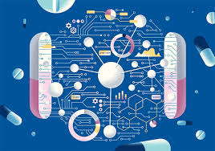
INTRODUCTION
Toxicity prediction in pharmacology is a crucial aspect of drug development and patient safety. Medications, while designed to treat diseases, have adverse effects that pose significant health risks.
There are countless potential entities of clinical trials and even after marketing many drugs have withdrawn due to high toxicity.
Toxicity prediction has relied on preclinical testing in animal models, clinical trials, and post-market surveillance.
TRADITIONAL METHODS
ADVANCED METHOD

Slide 3
ABSTRACT
Objective:
Predict toxicity of chemical compounds using machine learning.
Endpoints Analyzed:
Respiratory Toxicity, Mutagenicity, Eye Irritation, Hepatotoxicity, Endocrine Disruption, Reproductive Toxicity, CYP450 Inhibition Cardiotoxicity, Carcinogenicity, and LD50.
Result:
High Accuracy and F1 score for most of the end points.
LD50 Prediction Showed lower performance

Slide 4
METHODOLOGY
Pre-Processing:
Collected 10 toxicity datasets with different Toxicity endpoints.
Merged all datasets into a single unified dataset.
Converted SMILES Representation of a molecule into Morgan fingerprints(2047 bits)
Loaded fingerprint features on x.train.csv and labels on y.train.csv
Multi-Task-Learning:
Used a fully connected Neural Network with 2047 layers of molecular features
Hidden layer with 128 neurons, followed by ReLU activation.
9 Binary Classification Tasks (Sigmoid Activation): Respiratory Toxicity, Mutagenicity, Eye Irritation, Hepatotoxicity, Endocrine Disruption, Reproductive Toxicity, CYP450, Cardiotoxicity, Carcinogenicity.
1 Multi-Class Classification Task (LD50)
Used Evaluation metrics on Model to test its effectiveness and Robustness.

Slide 5
OUTPUT:
Toxicity Type | Accuracy | F1-Score | Sensitivity (Recall) | ROC-AUC Score
Respiratory Toxicity | 0.9877 | 0.9840 | 0.9877 | 0.8356
Mutagenicity | 0.9616 | 0.9585 | 0.9616 | 0.9694
Eye Irritation | 0.9533 | 0.9508 | 0.9533 | 0.9488
Hepatotoxicity | 0.9766 | 0.9682 | 0.9766 | 0.8476
Endocrine Disruption | 0.9931 | 0.9908 | 0.9931 | 0.8588
Reproductive Toxicity | 0.9967 | 0.9951 | 0.9967 | 0.8921
CYP450 Inhibition | 0.9654 | 0.9623 | 0.9654 | 0.9380
Cardiotoxicity | 0.9954 | 0.9945 | 0.9954 | 0.9713
Carcinogenicity | 0.9925 | 0.9896 | 0.9925 | 0.8724
LD50 | 0.7064 | 0.7027 | 0.7064 | N/A

Slide 6
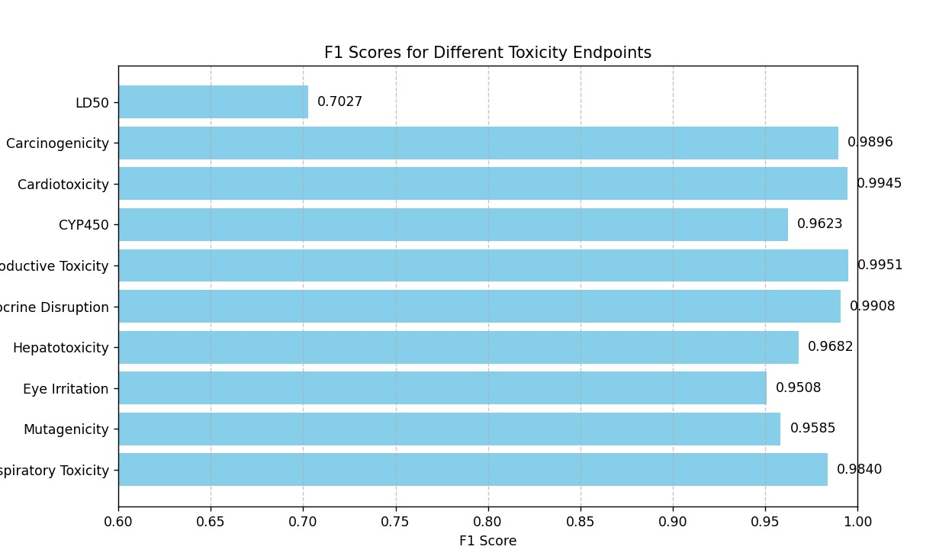
DISCUSSION:
1.The Poor performance of the model on LD50 maybe due to Class-Imbalance, inconsistent data.
Possible fix: Use Additional molecular descriptors and include hyper parameter tuning to improve the performance.
2. The strong performance of the other nine metrics, including high accuracy, precision, specificity, and MCC, highlights the robustness and reliability of the model in predicting toxicity, despite the lower performance observed for LD50.

Slide 7
WORKFLOW
In Silico Drug Toxicity Prediction
Develop an AI model to predict drug toxicity across multiple organ
Agent-Based Modelling (ABM)Finite Element Analysis (FEA)
Visualise drug interactions in 3D environments

Slide 8
FUTURE WORKS
IN SILICO ORGAN ON CHIP
FEA AND ABM FOR DRUG INTERACTION
IN SILICO CLINICAL TRIALS SIMULATIONS
FASTER DRUG DEVELOPMENT

Slide 9
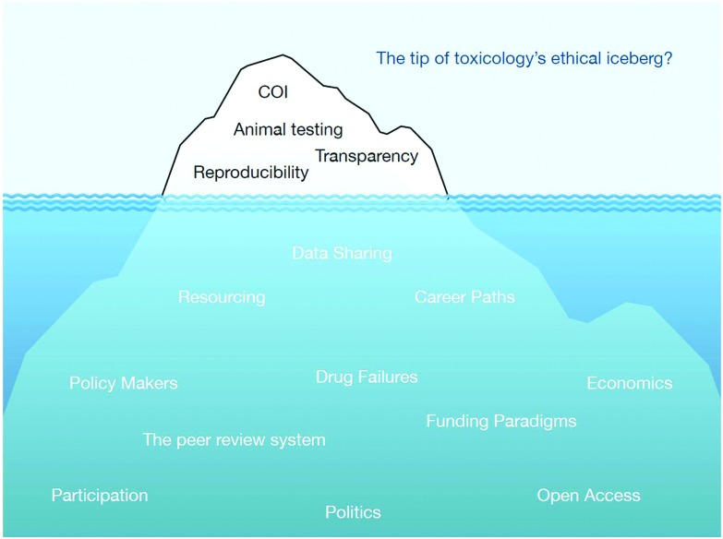
ETHICAL CONCERNS

Slide 10
INTELLECTUAL PROPERTY RIGHTS
Patent No.: US 2024/0161863 A1
Date:May 16 , 2024
Topic: Interrogatory cell based assays for identifying drug induced toxicity markers.
Authors:Niven Narain
Description: A platform tech for identifying markers with drug induced toxicity integrating with molecular interactions via organoids.
Patent No: US 2022/0383992 AI
Date: Dec,1,2022
Topic: Machine Learning based methods of Analysing drug-like molecules
Author: Kuano kevin
Description: machine learning based method to analysis drug structures.

Slide 11

BUSINESS ASPECTS
TARGET MARKET:
Pharmaceutical Companies: Drug discovery and clinical trials
Biotech Startups: Affordable and production value
Research Institutions: Simulate complex organ responses for academic and industrial research.
Regulatory Bodies: Provide drug datasets legally.
KEY VALUES:
Cost reduction: Reducing lab cost and experiments
3d visualization
Reduces time for preclinical trials.
REVENUE :
SAAS: Subscription model(software as a service)
Data licensing

Slide 12
THANK YOU

